Slide 1
Facial Key-Point Detection
- An Effort To Reduce Loss By Lasagne Modeling
Presented by : Jieli Chen
Date: 12/5/2018

Slide 2
Agenda
Introduction
Background
Motivation
Problem Statement
Data Understanding
Review of Related Work
LetNet Convolutional Neural Networks
Lasagne
Methodology
CRISP-DM
Data Augmentation
Modeling
Result Evaluation
Future Work
Demo

Slide 3
Introduction

Slide 4
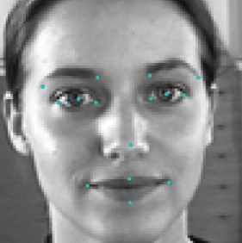
Introduction
Facial Key-Point
15 points of the face
left_eye_center, right_eye_center, left_eye_inner_corner, left_eye_outer_corner, right_eye_inner_corner, right_eye_outer_corner, left_eyebrow_inner_end, left_eyebrow_outer_end, right_eyebrow_inner_end, right_eyebrow_outer_end, nose_tip, mouth_left_corner, mouth_right_corner, mouth_center_top_lip, mouth_center_bottom_lip

Slide 5
background
Fundamental of face recognition
challenging problem
Difference of individuals’ generic appearances
Affected by other physical factors
Position
Viewing angle
Illumination condition
Contrast
Emotion of individuals

Slide 6
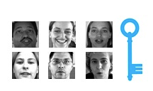
Motivation
Many Applications
Tracking faces in images and video
Analyzing facial expressions
Detecting dysmorphic facial signs for medical diagnosis
Biometrics / face recognition
A Kaggle competition (https://www.kaggle.com/c/facial-keypoints-detection)
Build my career path

Slide 7
Problem Statement

Slide 8
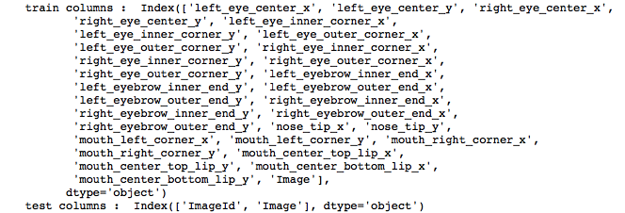
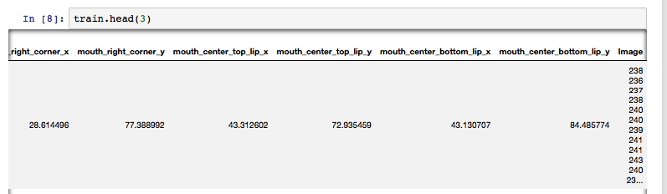
Dataset introduction
Train Dataset
7049 records
30 columns for 15 key-points x, y positions
1 column for image
Only 2140 records without x, y null value
Image
Greyscale range from (0, 255)
96 x 96 x 1
30 key-points x, y columns
x, y coordinate positions in 96 x 96 image
X, y ranging from (0, 95)

Slide 9
Problem Statement
Task
Predict 15 key-points x, y positions
Input
7049 images in the training set
15 key-points x, y positions
Output
1723 images without 15 key-points x, y positions
Predict the test set key-points x, y positions

Slide 10
Dataset introduction
Train Dataset
7049 records
30 columns for 15 key-points x, y positions
1 column for image
Only 2140 records without x, y null value
Image
Greyscale range from (0, 255)
96 x 96 x 1
30 key-points x, y columns
x, y coordinate positions in 96 x 96 image
X, y ranging from (0, 95)

Slide 11
Data Demo

Slide 12

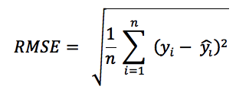
Evaluation Method
Supervised machine learning problem
Predict a value with target
Multiple Linear regression model
Evaluated by RMSE(root mean square error)

Slide 13
Review Of Related Work

Slide 14
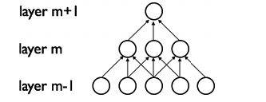
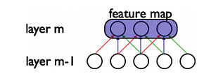
LetNet convolutional neural network
The first successful applications of Convolutional Networks were developed by Yann LeCun in 1998.
Reduce the number of parameters that need to be learned
local connectivity: neurons are connected only to a subset of neurons in the previous layer
Weight sharing: weights are shared between a subset of neurons in the convolutional layer (these neurons form what's called a feature map)
Pooling: static subsampling of inputs

Slide 15
Lasagne
Lightweight library to build and train neural networks in Theano
Main Features and Advantage
Supports feed-forward networks such as Convolutional Neural Networks (CNNs)
Allows architectures of multiple inputs and multiple outputs
Many optimization methods including Nesterov momentum, RMSprop and ADAM
Freely definable cost function and no need to derive gradients due to Theano's symbolic differentiation
Transparent support of CPUs and GPUs due to Theano's expression compiler
- Simplicity: Be easy to use, easy to understand and easy to extend, to facilitate use in research
Modularity: Allow all parts (layers, regularizers, optimizers, ...) to be used independently of Lasagne
- Transparent support of CPUs and GPUs
https://lasagne.readthedocs.io/en/latest/
https://github.com/Lasagne/Lasagne

Slide 16
Methodology

Slide 17
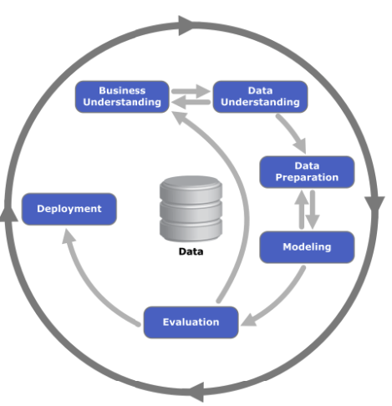
Methodology - CRISP-DM
cross-industry process for data mining
5 Main Steps:
Business Understanding
Data Understanding
Data preparation
Modeling
Evaluation and Deployment

Slide 18
Methodology - Data Understanding
Train Set
7049 Records
31 columns, 30 columns 15 key-points x, y positions
4909 records have null value (70%)
2140 records can be use to train model
Test Set
1783 Records
31 columns with 30 x, y positions to predict
Multi Linear Regression model
X input : the column ‘Image’
Y output : 15 key points x, y positions

Slide 19
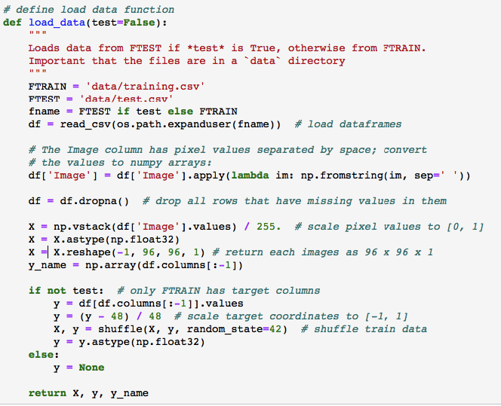
Methodology - Data preparation
Load data from CSV file
Drop 70% null value records
Define ’Image’ as X
Transform X to shape(1, 96, 96)
Define 30 columns as y
Scale pixel values to [0, 1]
Scale target coordinates to [-1, 1]
Change X data type to float32
Split train set into two parts
80% for train, 20% for validation

Slide 20
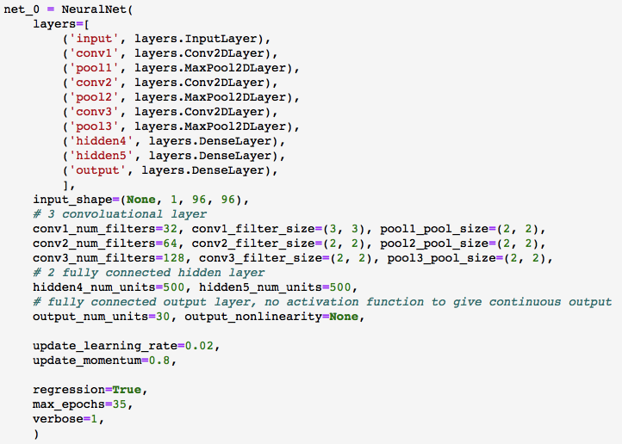
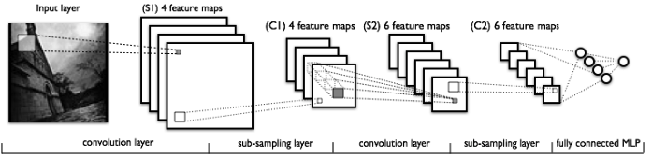
Methodology – Initial Modeling
LeNet5 CNN Model Architecture
3 convolutional layers
Pooling layer after each convolutional layer
2 fully connected hidden layers
30 unit output layer

Slide 21
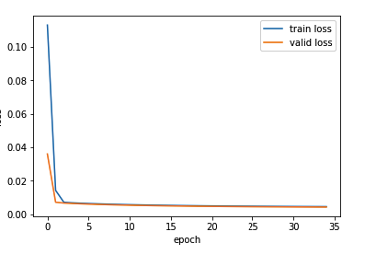


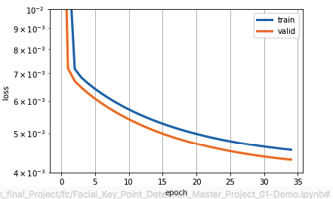
Methodology – Train and Initial Evaluation
RMSE 3.21
Train/valid Ratio 1.05

Slide 22
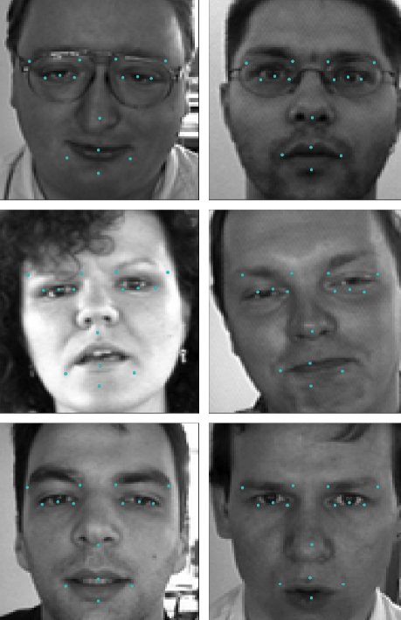
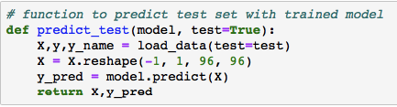

Methodology – Train and Initial Evaluation
Predict on test set with init model

Slide 23
Methodology – Improvement
Three directions for improvement:
Feature Engineering by data augmentation
Model Tuning based on initial model
Combine featuring and tuned model

Slide 24
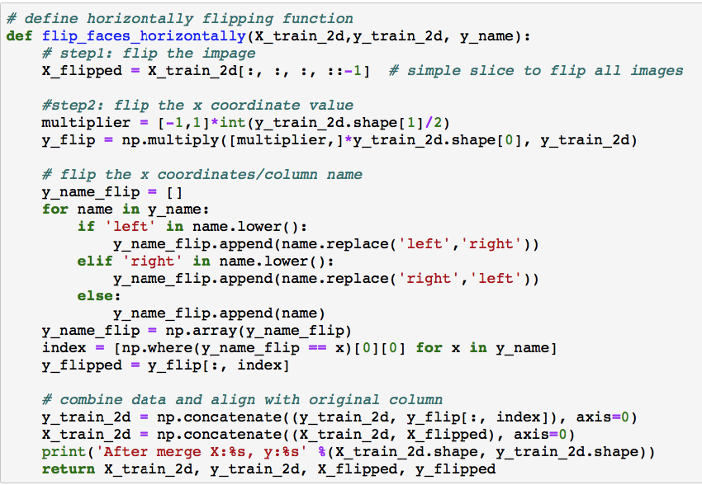
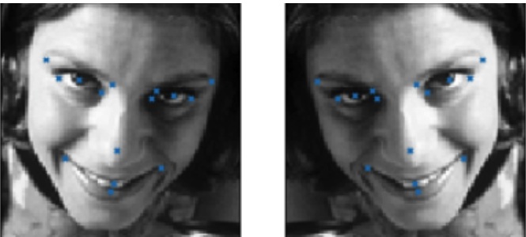
Data Augmentation - Horizontal Reflection
Actually Mirror image and key points
The corresponding relations before and reflection are:
left_eye_center_x -> right_eye_center_x
left_eye_center_y -> right_eye_center_y
left_eye_inner_corner_x -> right_eye_inner_corner_x
left_eye_inner_corner_y -> right_eye_inner_corner_y
left_eye_outer_corner_x -> right_eye_outer_corner_x
left_eye_outer_corner_y -> right_eye_outer_corner_y
left_eyebrow_inner_end_x -> right_eyebrow_inner_end_x
left_eyebrow_inner_end_y -> right_eyebrow_inner_end_y
left_eyebrow_outer_end_x -> right_eyebrow_outer_end_x
left_eyebrow_outer_end_y -> right_eyebrow_outer_end_y
mouth_left_corner_x -> mouth_right_corner_x
mouth_left_corner_y -> mouth_right_corner_y

Slide 25
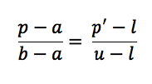
Data Augmentation - Histogram Stretching
A simple but effective image enhancement technique
Attempts to improve the contrast in an image by stretching the range of its pixel intensity to span a desired range of values
8-bit gray level images, the full range is from [0, 255]
histogram stretching algorithm
scans the entries to find the minimum and maximum pixel intensity values currently present in the image, a, b - [a,b]
Let [l, u] be the desired range that we would like to span
(here l = 0, u = 255
each pixel intensity value p in the original range [a,b] is mapped to a new value p′ in the desired range [l, u]
the proportion of p′ in [l, u] is the same as the proportion of p in [a, b]

Slide 26
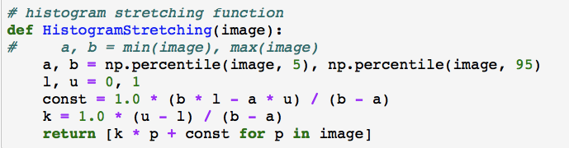
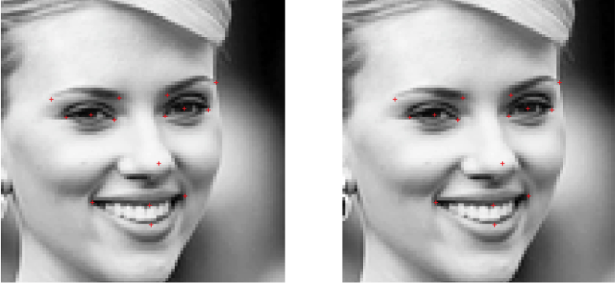
Data Augmentation - Histogram Stretching
The advantage of histogram stretching:
enhances the image contrast without distorting the relative gray level intensity values
range limits a and b is sensitive
robust version of histogram stretching, 5th, 95th

Slide 27
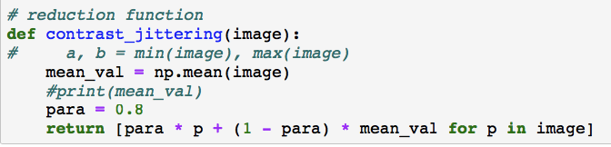

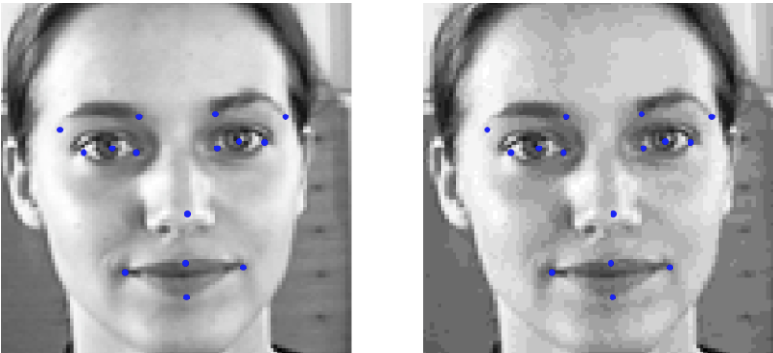
Data Augmentation - Contrast Jittering
Reduce the contrast of the greyscale image by
X is the 96 x 96 x 1 input
mean(X) is the average pixel value in X
Pixel values are shifted slightly towards the images mean pixel value
The degree of shift is determined by hyperparameter
Set 0.8 for this problem

Slide 28
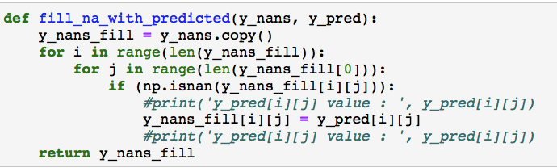
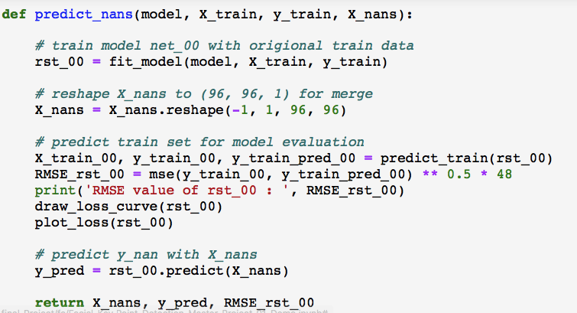
Data Augmentation – Fill all null records with predict value
We have 4909 Records with null value inside
Some images are all null in 30 columns
Some images are partial null value in 30 columns
Predict 15 key points x, y positions with init model
Two scenarios:
Only fill these null values, keep some of key points position values
Replace all 30 columns with predicted values

Slide 29
Model Tuning
What and Why ?
machine learning algorithms have a “default” set of hyperparameters
defines as “configuration variables
internal to the model and whose value can be estimated from data
generic set of hyperparameters for each algorithm provides a starting point for analysis
In order to find the best hyperparameters for your data, we need to tune them
trial-and-error process
For this problem and algorithm I choose 3 paras:
Learning rate
Epoch
momentum

Slide 30
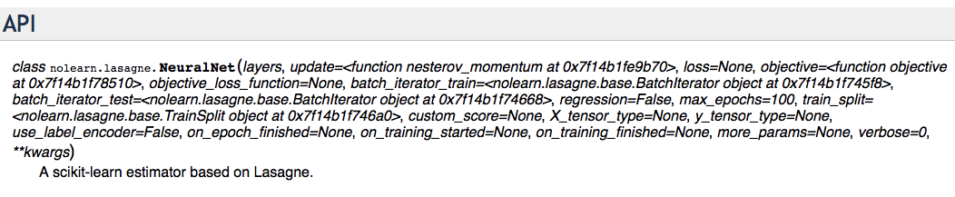
Model Tuning
For this problem and algorithm I choose 3 paras:
Learning rate. 0.02 – 0.01
Epoch 35 - 200
Momentum 0.8-0.9
https://pythonhosted.org/nolearn/lasagne.html

Slide 31
Result Evaluation

Slide 32
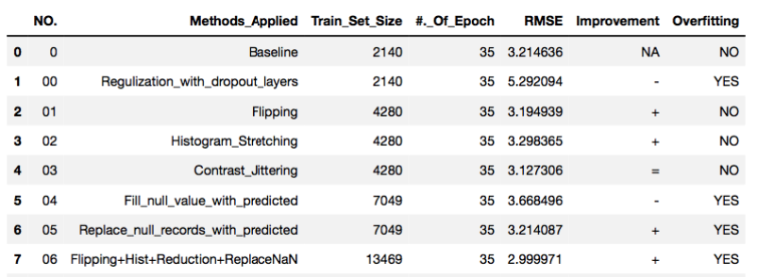
Data Augmentation Results Evaluation
RMSE Analysis

Slide 33
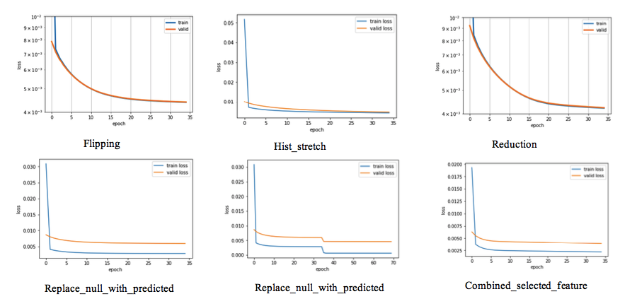
Data Augmentation Results Evaluation
Train/Validate Loss Analysis

Slide 34
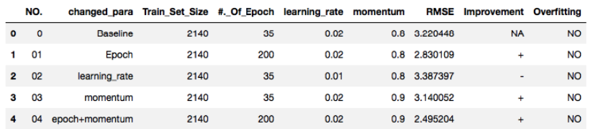
Model Tuning Results Evaluation
RMSE Analysis

Slide 35
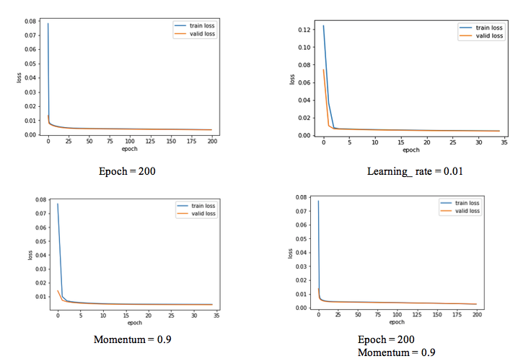
Model Tuning Results Evaluation
Train/Validate Loss Analysis

Slide 36
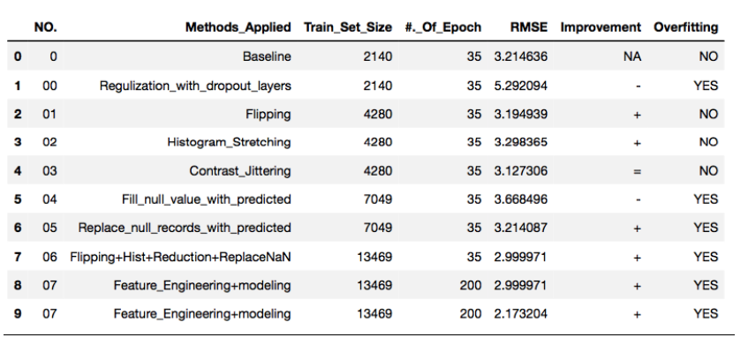
Combining Model Tuning and Augmentation Results Evaluation
RMSE Analysis

Slide 37
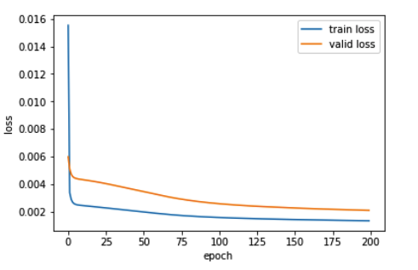
Combining Model Tuning and Augmentation Results Evaluation
Train/Validate Loss Analysis
Train/valid ratio is 0.67

Slide 38
Future Work

Slide 39
Future Work
The final RMSE is 2.17 with the model that is a little bit overfitted
More effort and work are still required to reduce it to less than 1 for application purpose
The effort could be in several directions as well
Model tuning for some key parameters like epoch and learning rate, etc
Featuring engineering by grouping some key-points. For example, we can separate them into at least two groups, group1 for mouth key-points and group2 for other key-points
Use PCA modelling

Slide 40
Demo

Slide 41
Question ?

